Slide 1
Magist - Eniac Analysis
Evaluating Magist as a fulfilment partner for
ENIAC’s Brazilian expansion
Published by: Pavana Kumari

Slide 2
Business Problem:
1. Can Magist support ENIAC’s entry into Brazil?
2. Product Fit: Can Magist support high-end technology products?
3. Tech Sellers: Can Tech sellers do good business with Magist?
4. Delivery Performance: Can Magist provide reliable delivery?
5. Delivery risk?
ENIAC can sign the conditional contract with MAGIST
Geographic
Product Fit
Seller Perf.
Delivery Perf.
Delivery Risk
Notes:
Tech = ~21% of units sold, Tech sellers = ~26% of sellers, Tech sellers = ~53% of revenue, ~89% delivered on time, Late delivery strongly affects reviews

Slide 3
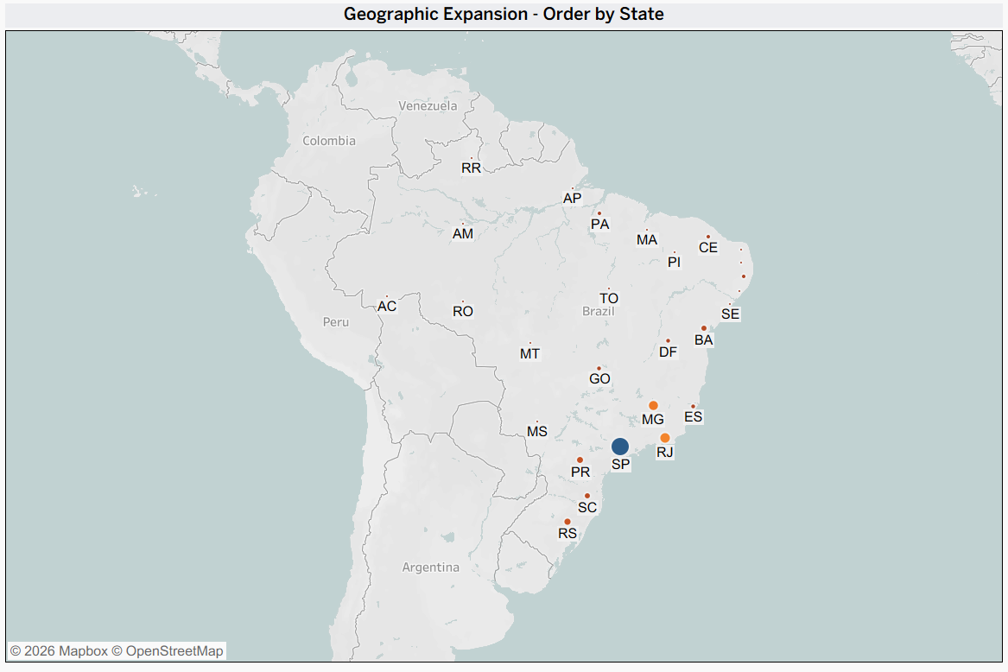
Notes:
Demand and sellers are both concentrated in São Paulo/Southeast — an established ecosystem for launch, though thinner elsewhere

Slide 4
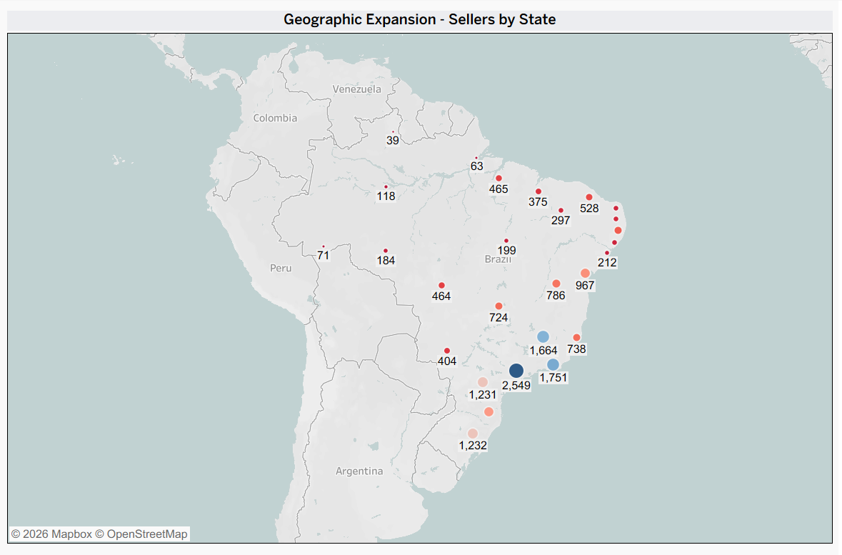
Notes:
Demand and sellers are both concentrated in São Paulo/Southeast — an established ecosystem for launch, though thinner elsewhere

Slide 5

Notes:
Demand and sellers are both concentrated in São Paulo/Southeast — an established ecosystem for launch, though thinner elsewhere

Slide 6
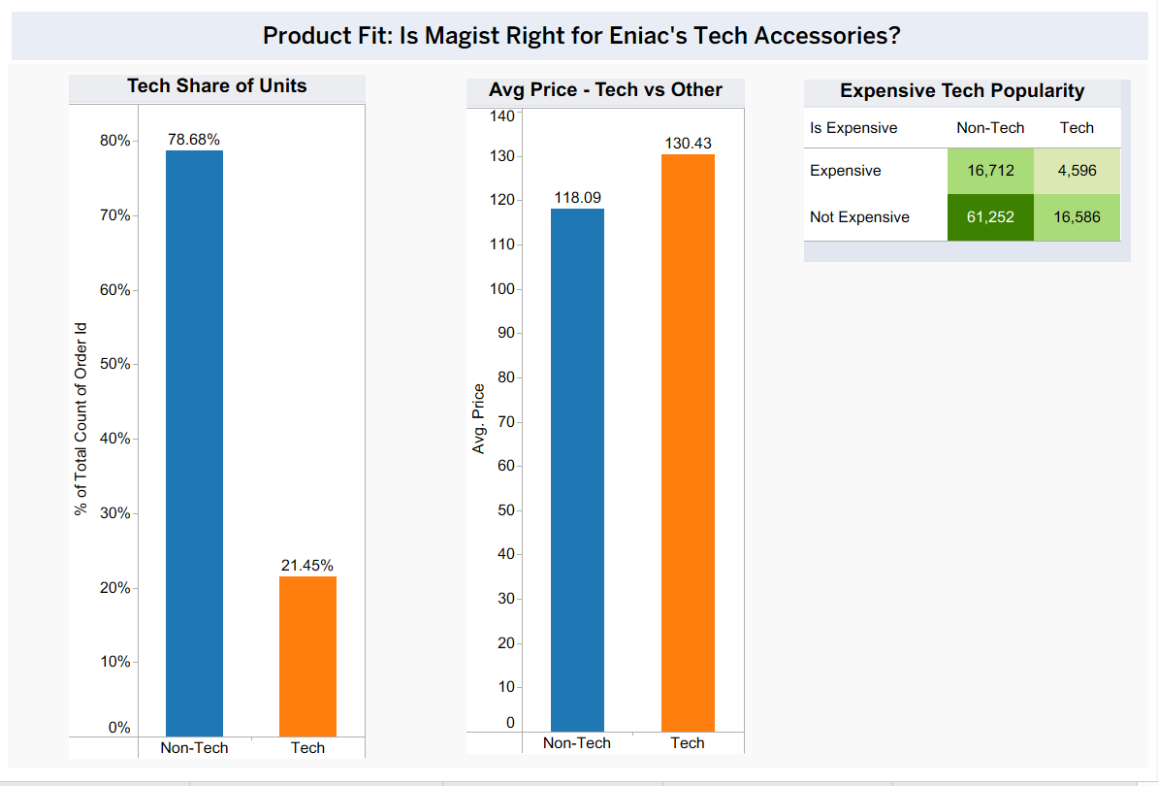
Notes:
Tech = 21.45% of units sold, avg price R$130.43 vs R$118.09 non-tech — smaller volume, real premium.

Slide 7
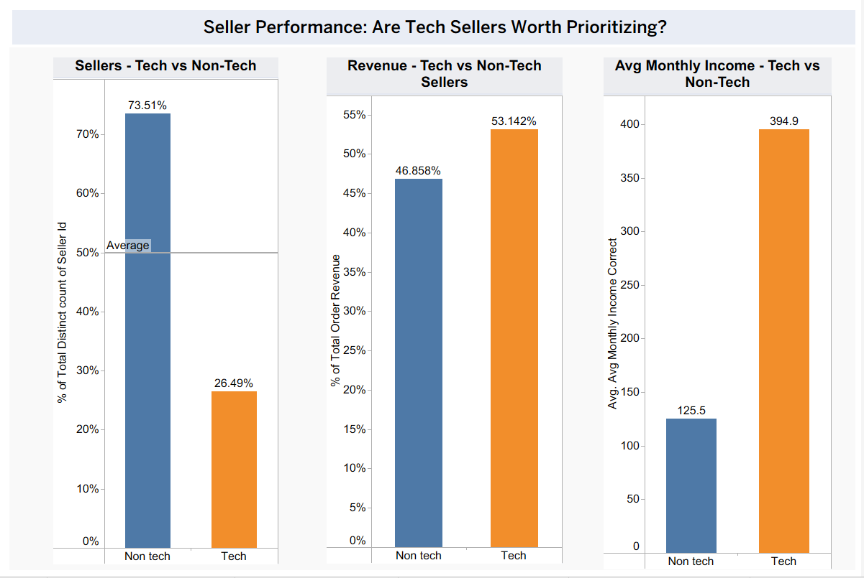
Notes:
26.5% of sellers, but 53% of revenue and ~3x the monthly income of non-tech sellers — Magist's strongest performers.

Slide 8
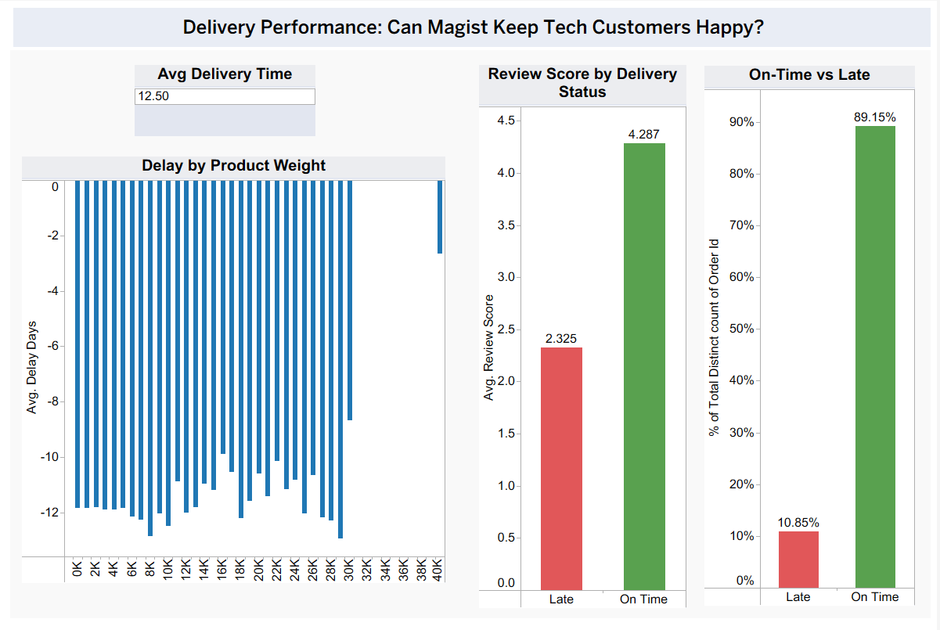
Notes:
89% on-time. Late orders see satisfaction drop sharply (4.3 → 2.3 review score). Weight shows no clear link to delay — good news for lightweight tech accessories.

Slide 9
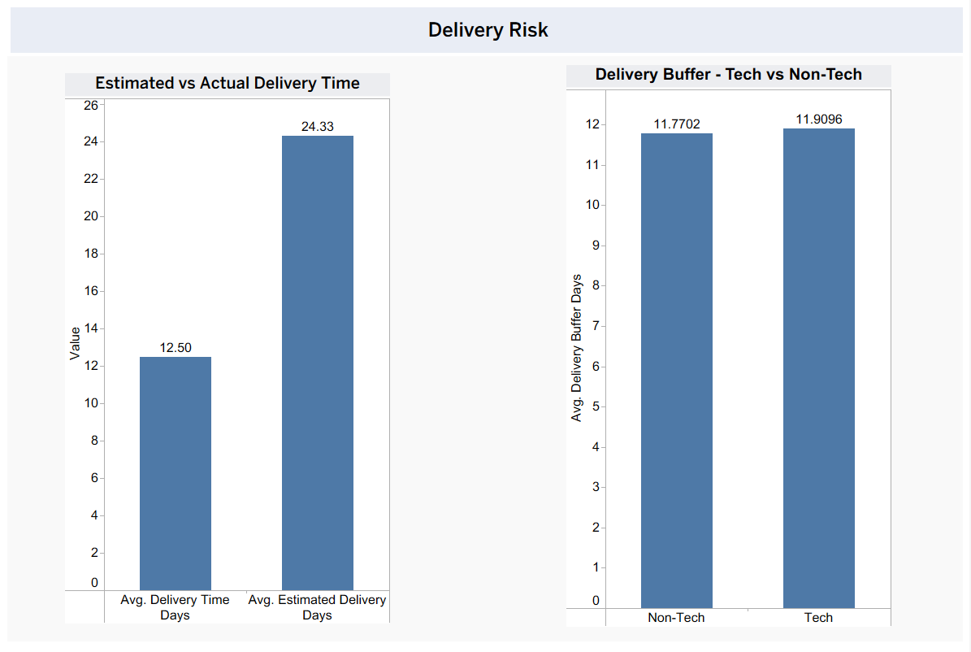
Notes:
Orders consistently arrive before the estimate, but the estimate itself is long (~11.8-11.9 days of buffer, tech and non-tech alike). Risk is inflated checkout expectations, not actual performance.

Slide 10
Conclusion :
Magist is a strong operational fit for Eniac: an established Southeast ecosystem, a real tech price premium, and tech sellers that outperform the platform average. Delivery is reliable in practice — the only weak point is a delivery estimate that's longer than performance justifies, which could discourage premium buyers at checkout.
Recommendation:
Proceed with a conditional 3-year partnership, contingent on Magist tightening its estimated-delivery algorithm to better reflect actual (faster) performance.
ENIAC can sign the conditional contract with MAGIST

